Slide 1

Introduction to
Artificial Intelligence
www.BigDataTrunk.com

Slide 2
Introduction
Antony Ross
Data Science and Machine Learning
Sports performance data
Research in music recommendations and voice recognition
Presently working with financial data

Slide 3
Agenda
01
AI Overview
02
Neural Networks
03
Computer Vision
04
Understanding Language
05
Demo TensorFlow & Auto ML
06
Next Steps

Slide 4
Logistics
Timing – 9 to 12 PM PST
Periodic Breaks – At logical points

Slide 5
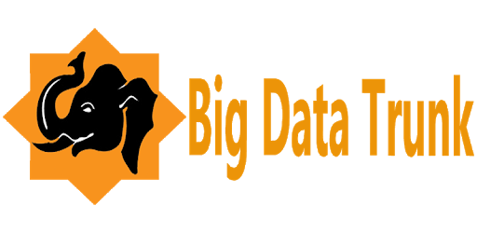

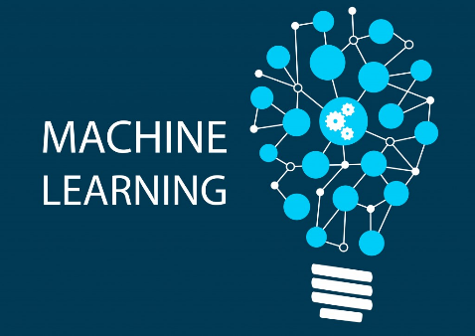

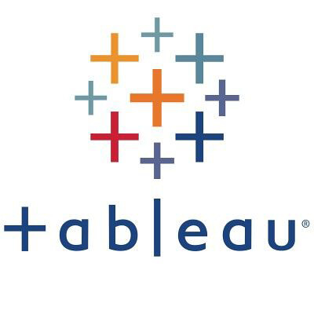

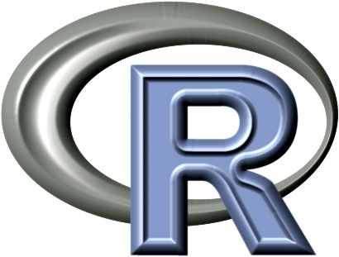
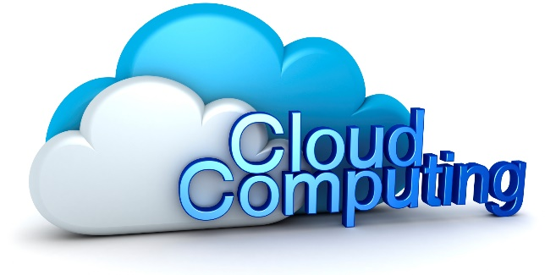
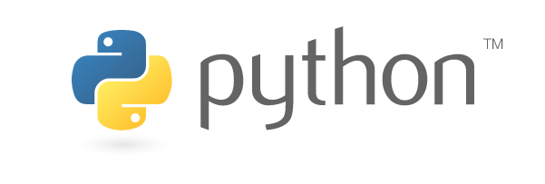
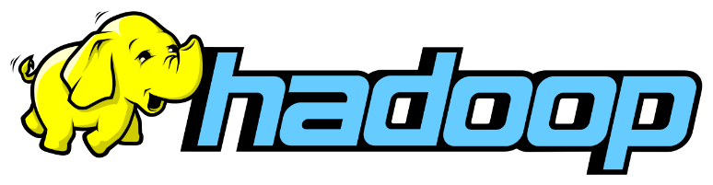

Stanford &

Slide 6
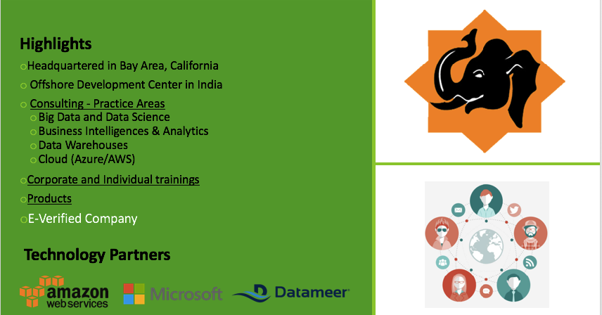
Big Data Trunk

Slide 7
AI Overview

Slide 8
Deep Learning
&
Convolutional Neural Networks

Slide 9
Recurrent Neural Networks

Slide 10
TensorFlow Demo

Slide 11
Survey Time
http://ttseval.stanford.edu

Slide 12
Next steps
Make a custom plan for yourself to continue this journey
Improve some of your skills (Python, ML, DL, Domain, etc.)
Take some additional courses
Try a Kaggle.com competition
Work on a personal project to improve understanding

Slide 13
Useful Machine Learning and Deep Learning books for beginners to intermediate:
Book | Author
An Introduction to Statistical Learning | Robert Tibshirani and Trevor Hastie John W. Foreman
Python Machine Learning | Sebastian Raschka and Vahid Mirjalili
The Hundred-Page Machine Learning Book | Andriy Burkov
Neural Networks and Deep Learning | Michael Nielsen
Deep Learning | Ian Goodfellow, Yoshua Bengio, and Aaron Courville

Slide 14
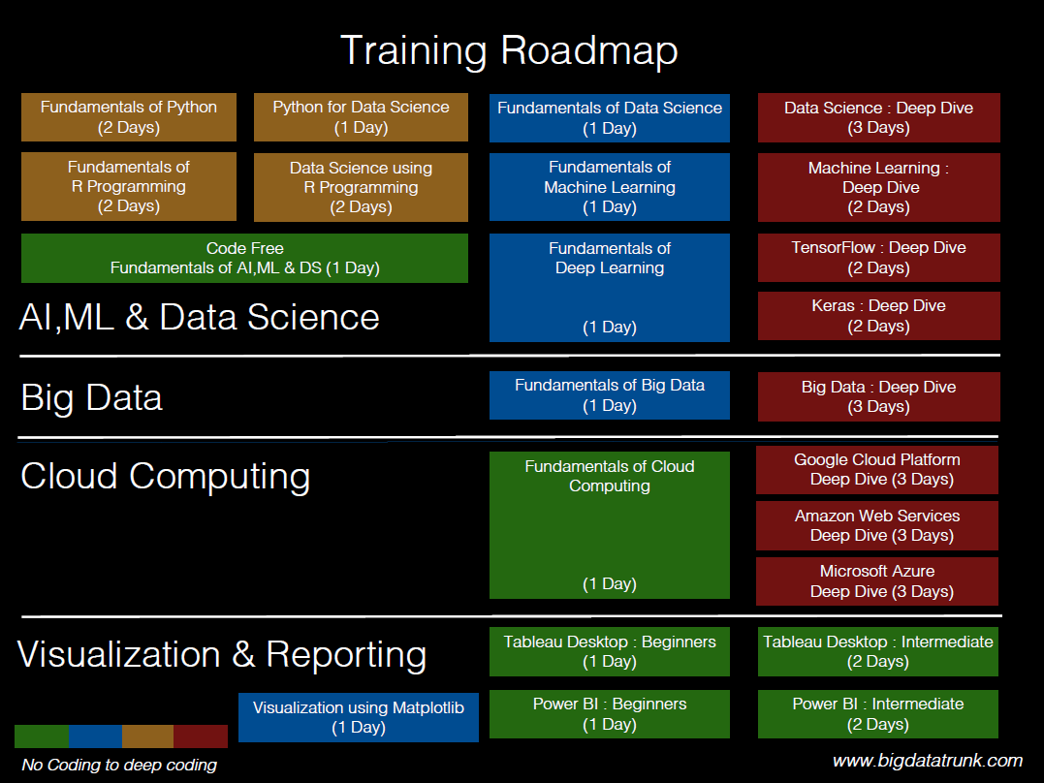

Slide 15
Stanford Upcoming Training
Click here for latest schedule

Slide 16
